Slide 1
Studio Year in Review
Teaching notes from the season, Parkside Dance Academy
Jason Cooper, Choreographer and Senior Instructor
01 / 07

Slide 2
THE STUDIO
Sixty dancers, six levels
Parkside has 180 students enrolled. I teach about sixty directly across six levels, classes from ten to one and four to six most days, with Wednesday afternoons protected for choreography.
180
enrolled at the academy
60
taught directly
6
levels
2
showcases a year
02 / 07

Slide 3
ENROLLMENT
Dancers by level
60 dancers
The lower levels carry the larger classes. Pointe testing begins in Level 4 and the upper corps holds steady at the most committed.
03 / 07

Slide 4
POINTE READINESS
Where the cohort stands
Pointe is earned, not aged into
Twenty six dancers are on pointe, six are testing this term, and the rest are building the ankle strength that has to come first.
04 / 07

Slide 5
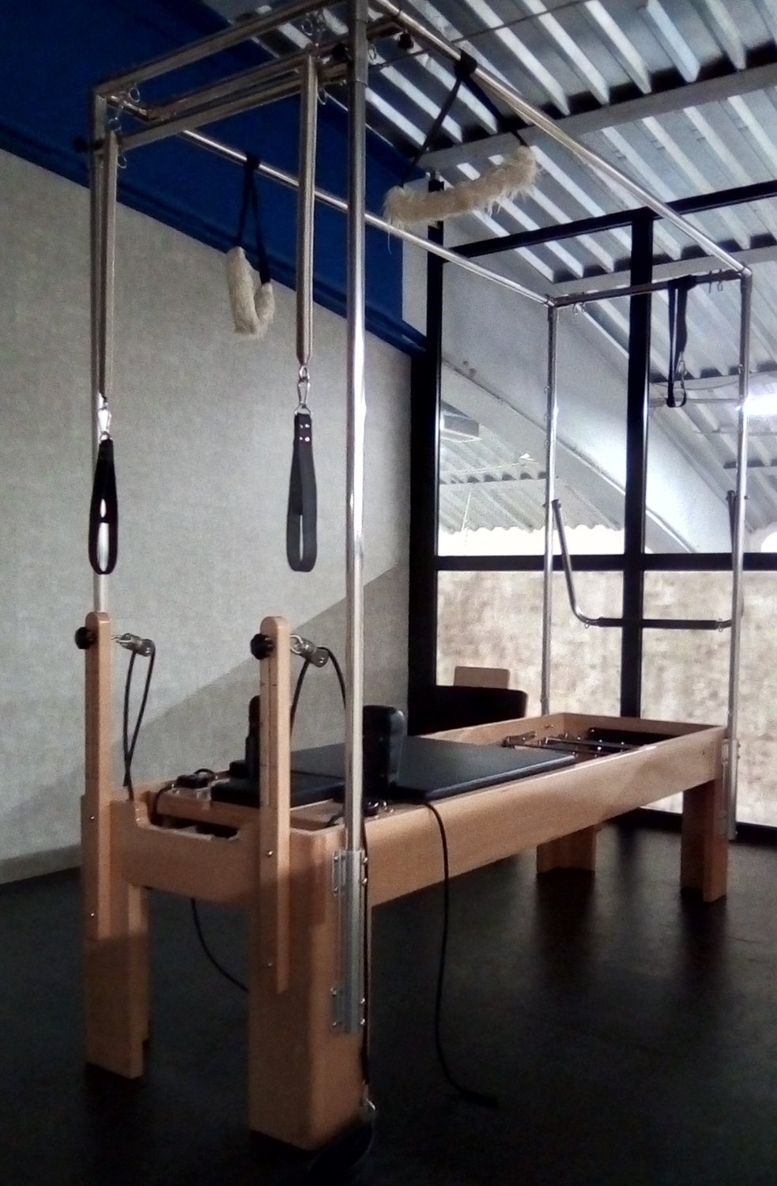
TRAINING DISCIPLINE
A dancer's body at thirty nine
Reformer Pilates, Monday, Wednesday, and Friday at 6:30, with a forty five minute floor stretch every morning.
Custom ankle brace on before any teaching block. The point is symmetry.
Reformer sessions, average heart rate
05 / 07

Slide 6
MUSIC AND REPERTOIRE
The rehearsal cue sheet
Work | Composer | Use
Appalachian Spring, Variations | Aaron Copland | Movement I
Rodeo, Hoe Down | Aaron Copland | Warm up energy
Waltz of the Flowers | Tchaikovsky | Winter corps
Symphonic Dances | Leonard Bernstein | Senior class
Nocturne in E flat | Chopin | Adagio and stretch
Clair de Lune | Debussy | Cool down
06 / 07

Slide 7
Breakthroughs are earned in the boring repetitions,
and this group has not yet fallen in love with the boring part.
Ahead: Dance Educators Symposium, October 17 to 18 . Winter Showcase, December 12 to 13
07 / 07

